Slide 1
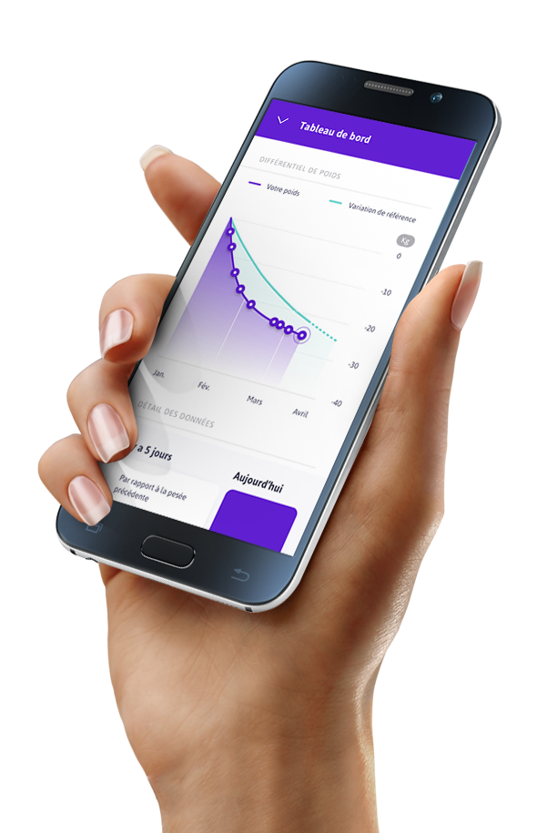
Inscription

Slide 2
patients.ebaros.com

Slide 4
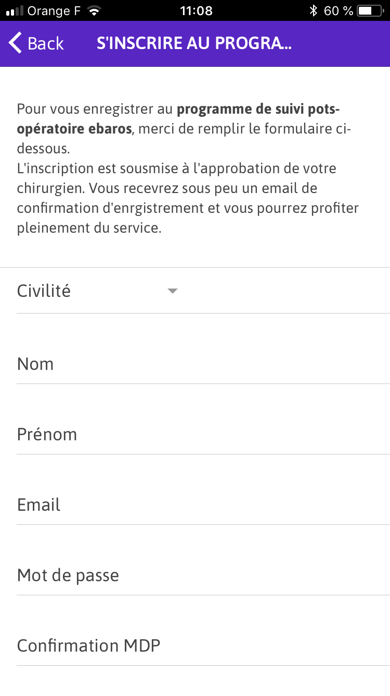

Slide 5
